Slide 1
Crypto-Currencies – Feb 20
Agenda
Warm-Up Quiz
Case C.1 Crypto-Currencies
Begin Level 1 today
Continue levels 2 and 3 tomorrow
NOTE: Re-Download tomorrow for latest version!!!
Upcoming
Past Due: Module B.1 Python Programming Intro
Tomorrow: Supply Day / Continue Case C.1

Slide 2
Warm-Up Quiz
Predict the result of the following code:
colours = ['red', 'green', 'blue']
print(colours[1])
What value of the variable 'a' will result in "y" being printed by the following code?
title = "I like Python"
print(title[a])

Slide 3
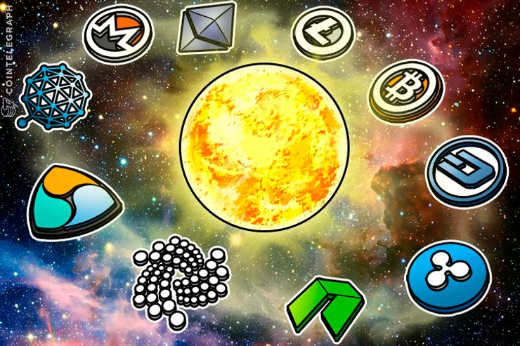
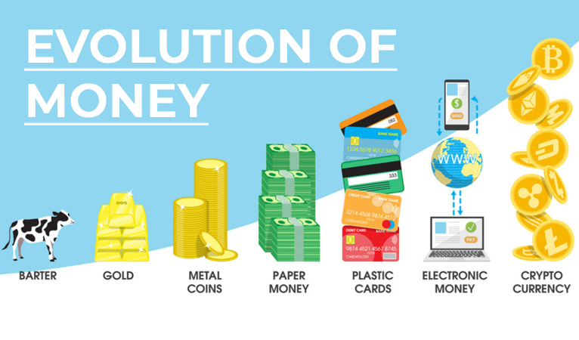
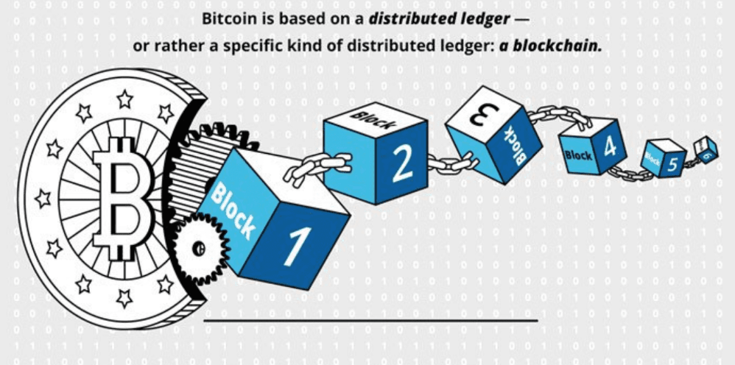
Crypto-Currencies

